Slide 1
Final Project
Team Red:
Alexander Peries
William Rash
Kevin Walter Conejo Molina

Slide 2
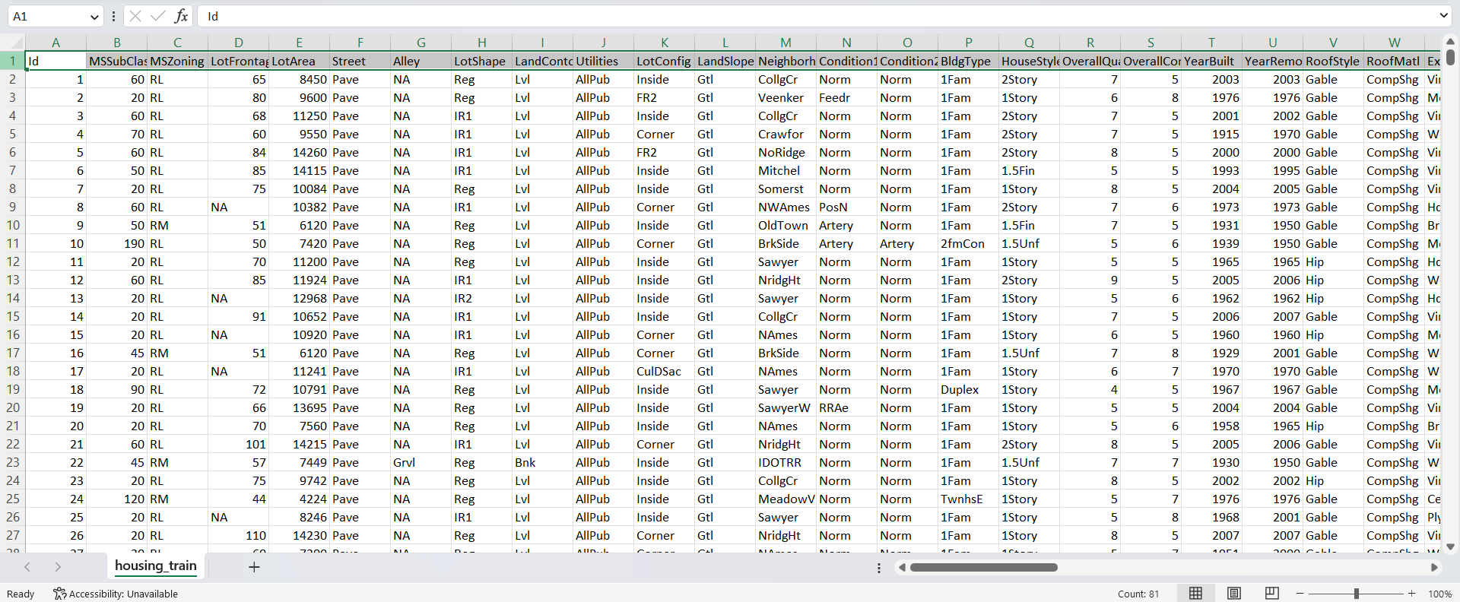
Data
81 Columns
1460 Rows
Link to our dataset: https://www.kaggle.com/datasets/gpandi007/usa-housing-dataset

Slide 3
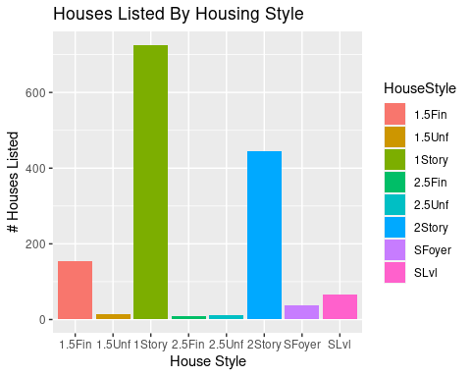
In this bar plot, we chose to examine the relationship between the houses listed and the house style.
We found that 1 story houses were the most prevalent of those listed, followed by 2 story houses.
While 2.5 story houses with a finished second level were the least likely to be listed.

Slide 4
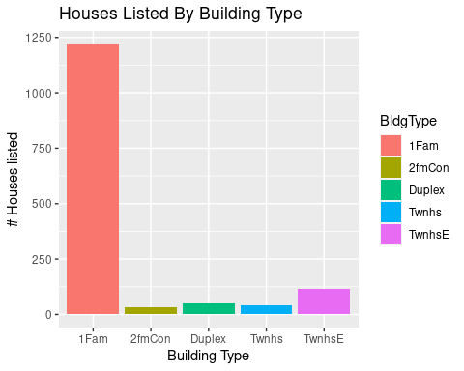
In this bar plot we examine the relationship between the houses listed and the building type.
According to the data, we found that single-family detached houses were by far the most common, with nearly 1250 listed.
Townhouse end units come in second in terms of frequency among the listed houses, but are still far less common at about 125 listed.
The least common building type listed was the two-family conversion (houses that were originally built as single-family), with approximately 35 listings.

Slide 5
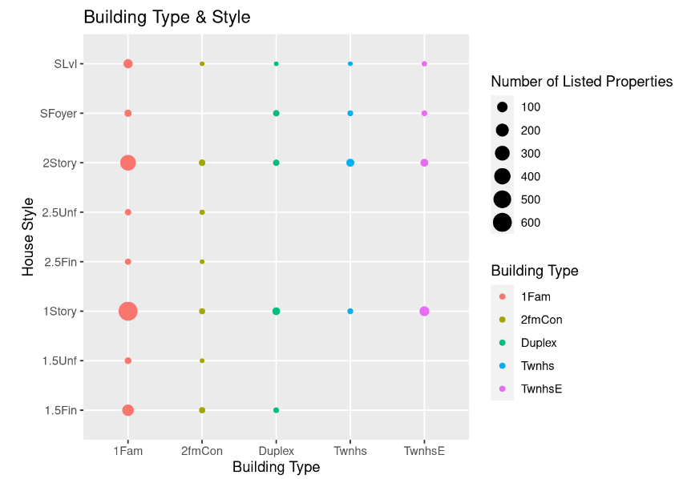
In this plot we examined the relationship between several variables: the house style, building type, and number of listings.
The most common combination of house style and building type we found listed was the 1-story, single-family home, followed closely by the 2-story, single-family home.
In general, we noticed that regardless of house style, single-family homes tended to outnumber all other building types.
And, as established in the previous plot, two-family conversions were the least frequently listed houses, despite having a greater variety of house styles than the similarly uncommon townhomes.
Altogether, this indicates that building type may play a more significant role than house style in terms of which house characteristics prospective homebuyers are prioritizing.

Slide 6
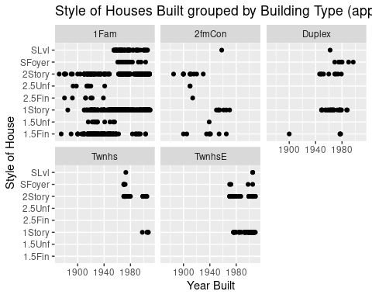
In these plots we examined the relationship between house style and year built for each building type.
With regards to single-family homes, 2 story houses and 1.5 story houses with a finished second level seem to be the most consistently built homes since the late 1800s, with 1 story houses eventually exceeding their frequency after 1900.
Two-family conversions, while never particularly common, were more prevalent prior to the 1970s, after which they stopped being built entirely.
Duplexes, on the other hand, only started being built in (relatively) large numbers after 1940.
Similarly, we found that townhomes, regardless of style or type, only started being built around the 70s.
Additionally, across all building types, 1 and 2 story house styles tended to be the most common.

Slide 7
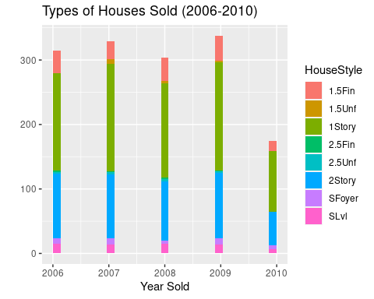
In this graph we examined the relationship between the house style, the year sold, and the number of listings.
Of the houses sold in any given year, 1 story homes were the most prevalent – usually consisting approximately 50% of the listings.
On the other hand, 2.5 story homes tended to be among the least frequently listed.

Slide 8
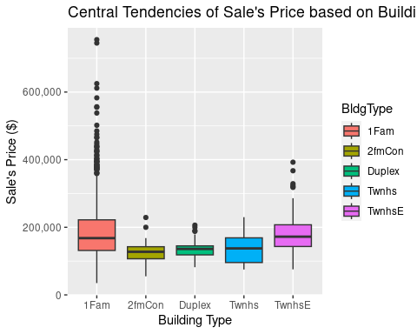
In this graph we examined the relationship between building type and sale price.
Single-family homes and townhouses seemed to have comparable median sale prices, though the single-family homes did have a significantly higher number of more expensive outliers.
The single-family homes also had a slightly lower minimum sale price, though this wider range is likely in part due to there being many more single family homes listed than townhomes and the greater variety of house styles that single-family homes have.

Slide 9
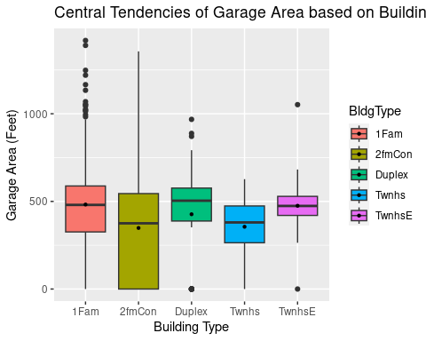
In this graph we examined the relationship between building type and garage area.
Interestingly, the two-family conversions seemed to have the greatest spread/interquartile range in terms of garage area, with all the other building types having, in comparison, relatively consistently sized garages.
However, as in the previous graph, the single-family homes still have the greatest number of outliers on both ends.

Slide 10
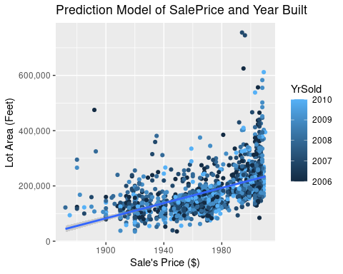
In this graph, we examined the relationship between the year the houses were built, the sales price, and the year they were sold.
In general, we found that the later the houses were built, the more they were sold for – likely a function of inflation.
The year sold, on the other hand, did not seem to have as much of a discernible relationship with the sales price.

Slide 11
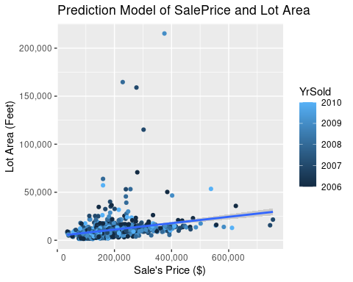
In this graph, we examined the relationship between the sale price, lot area, and year sold.
We found that as the sale price increased, the lot area would also increase, albeit at a relatively low rate.
We also noticed that there were a fair number of outliers that had relatively average or slightly above-average sales prices, but significantly higher lot areas than comparably priced homes.
These outliers likely represent farmland or rural lots in which the price per acre is significantly lower than the price in more suburban or urban areas.

Slide 12
Q&A

